Slide 1
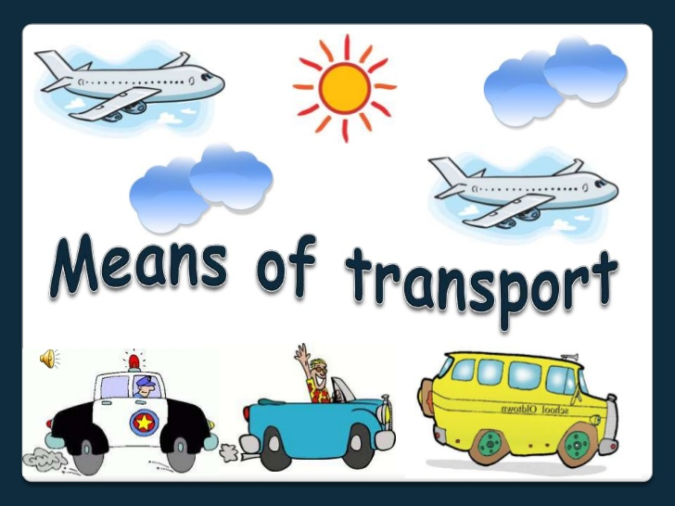
TRAVEL HABIT

Slide 2

IN THE AIR
AT SEA
ON LAND

Slide 3
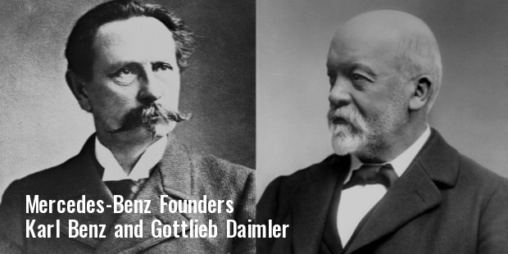

Slide 4
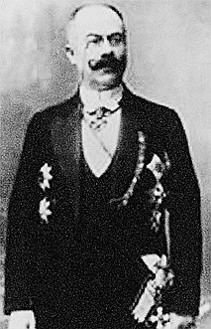
Ellinek created the Mercedes trademark in 1902, naming the cars after his daughter

Slide 5
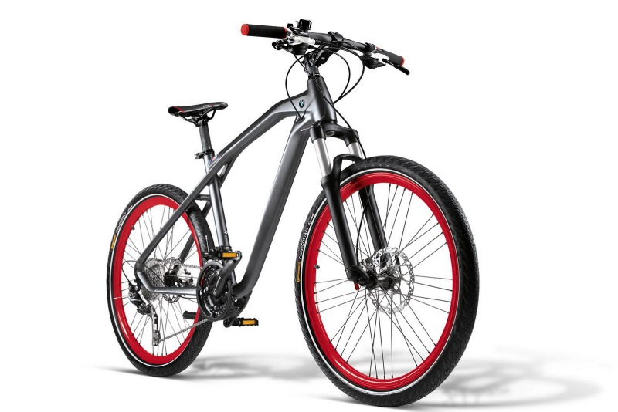
ON LAND
Bike: xe đạp = Bicycle
/baik/ /'baisikl/
TRANSPORT

Slide 6
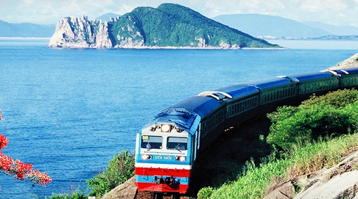
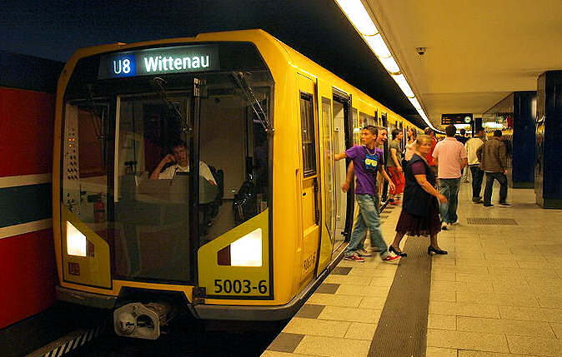
Train: Tàu hỏa
/trein/
Subway: Tài
điện ngầm
/'sʌbwei/
Underground
Metro

Slide 7
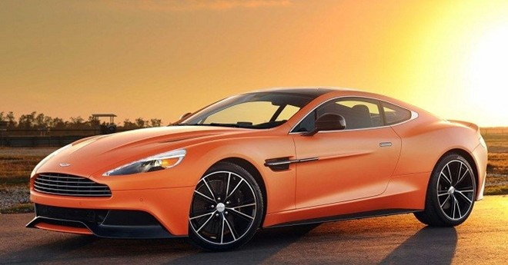
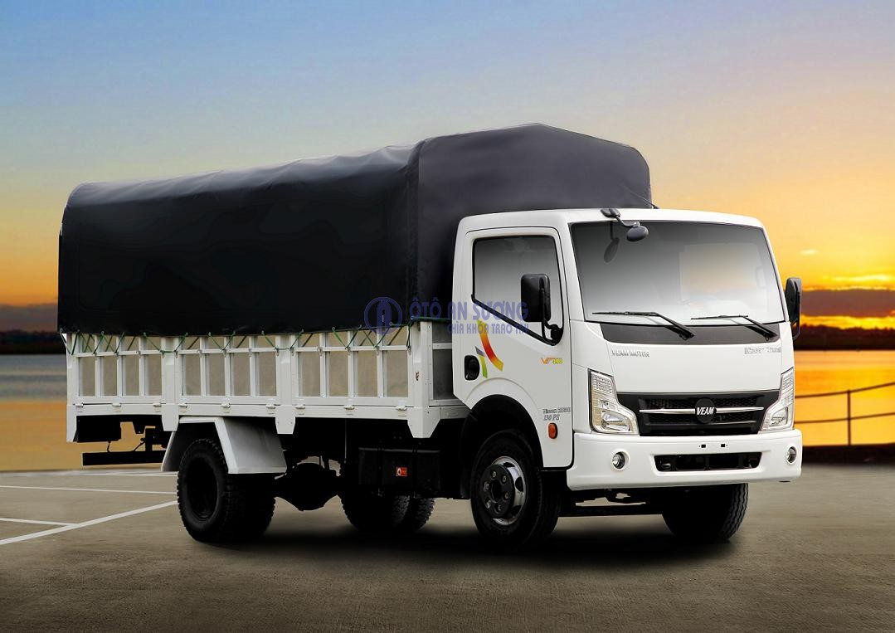
Car: xe hơi
/kɑ:[r]/
Van: xe thùng
/væn/

Slide 8
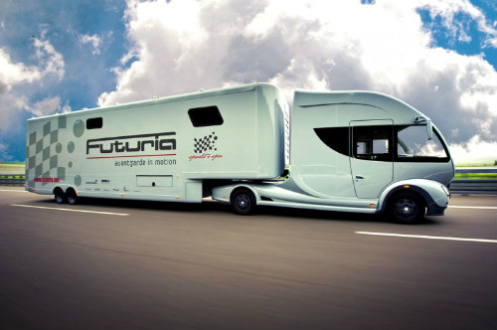
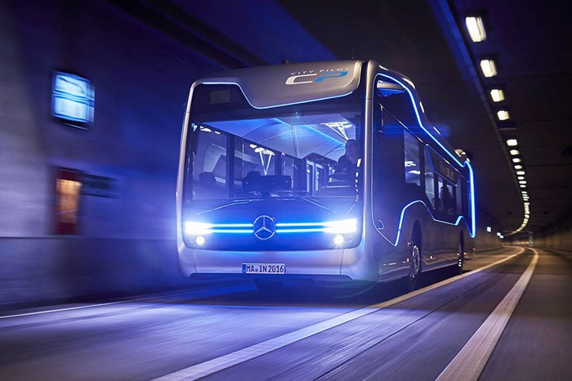
Caravan: xe nhà lưu động
/'kærəvæn/
Bus: xe buýt
/bʌs/

Slide 9
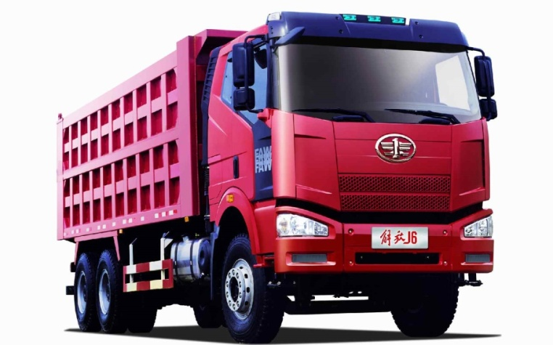
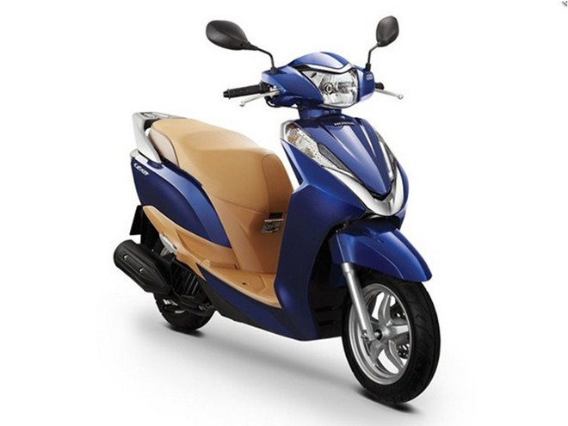
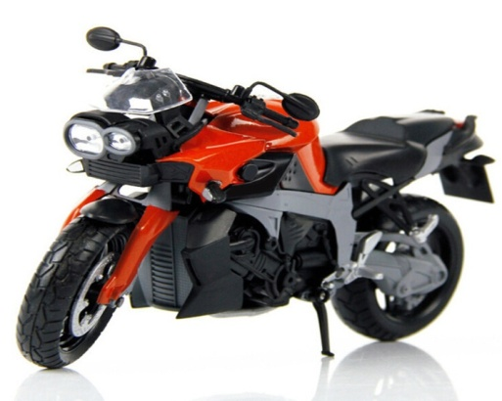
Lorry/truck: xe tải
/'lɒri//trʌk/
Scooter: xe ga
/'sku:tə[r]/
Motorbike: xe motor
/'məʊtəbaik/

Slide 10
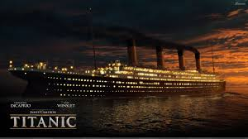
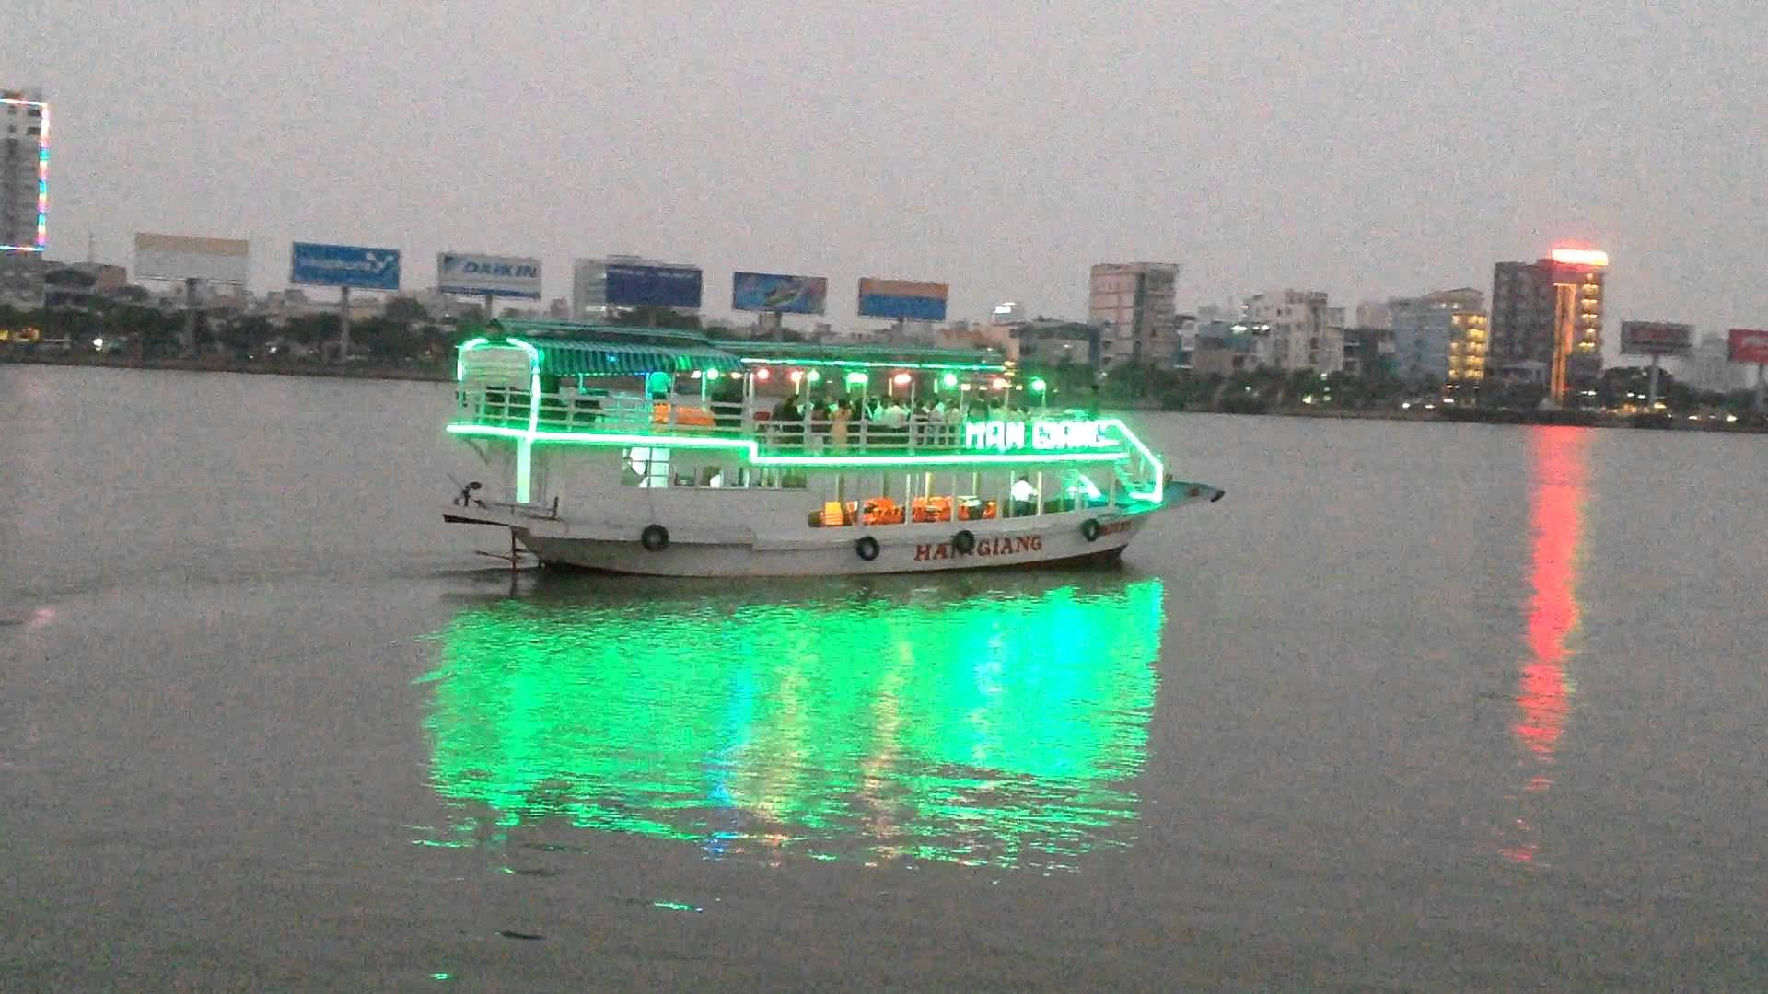
AT SEA
Ship: Tàu thủy /∫ip/
Boat: Thuyền
/bəʊt/

Slide 11
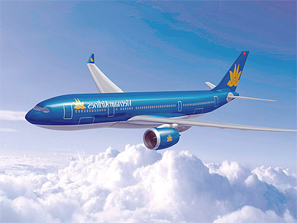
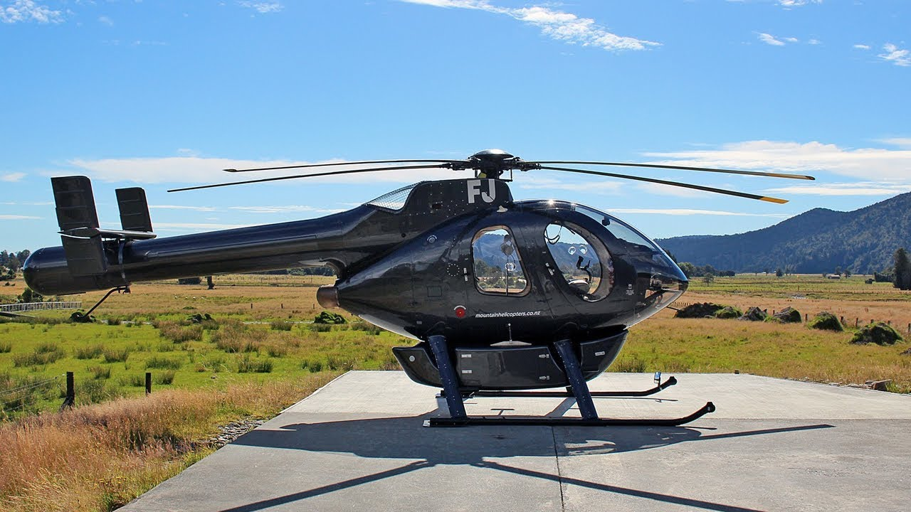
IN THE AIR
plane: Máy bay
/plein/
Helicopter: trực
thăng
/'helikɔptə/

Slide 12
RIDE/ DRIVE/ GO BY/ TAKE
ride
Can you .....................a motorbike?
He works for a railway company. He ..............a train
She sometimes .....................the underground to work.
I prefer to ...................a bus than ...............a car
Would you like to .................an elephant
You never forget how to ................a bike
I usually .................a taxi when it rains
He often ................plane when he travels far away from home
takes
takes
take
drive
ride
ride
take
takes

Slide 13
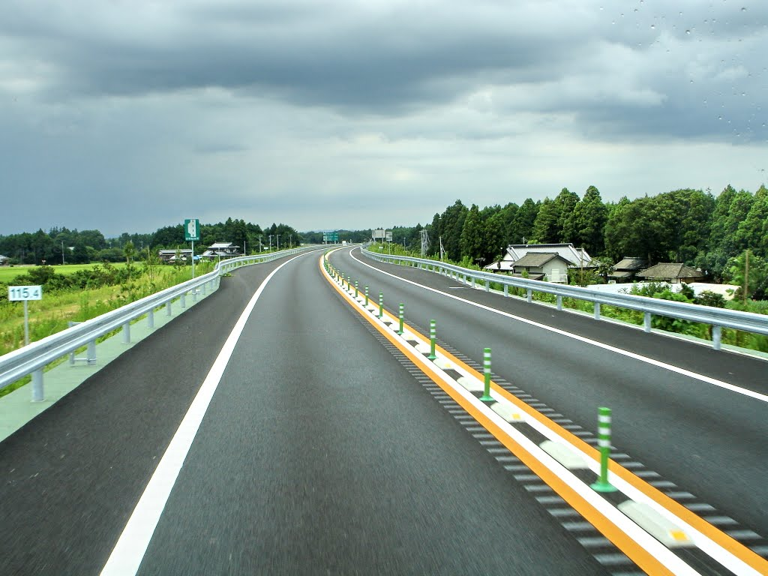
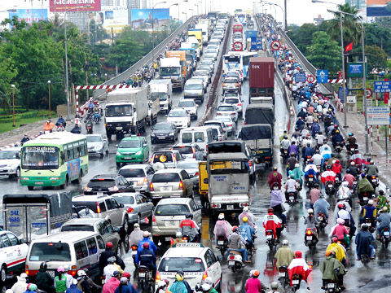
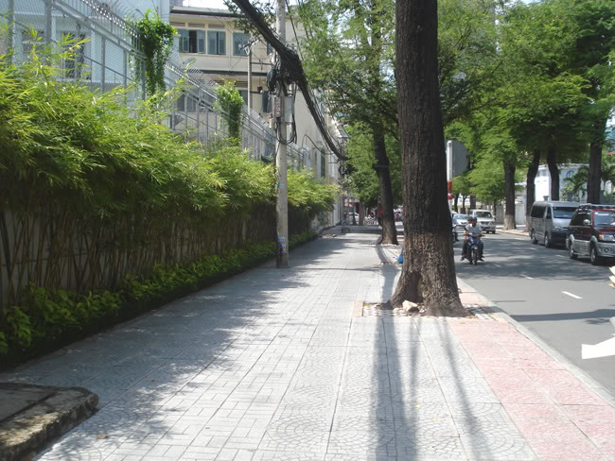
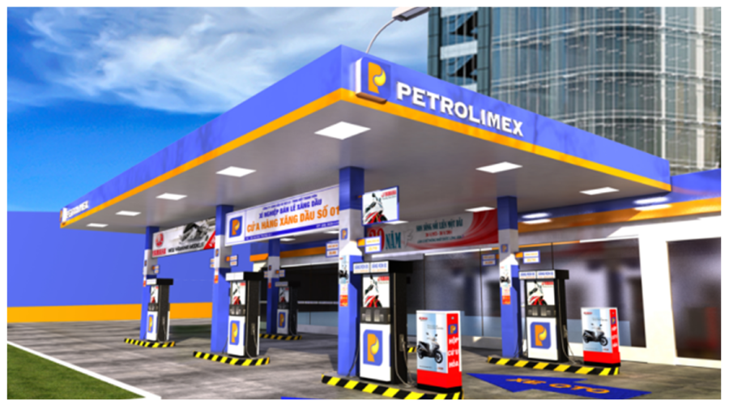
Road: con đường
/rəʊd/
Traffic Jams: kẹt xe
/'træfikdʒæm/
Roadside: lề đường
/'rəʊdsaid/
Petrol station: trạm xăng
/'petrəl 'stei∫n/

Slide 14
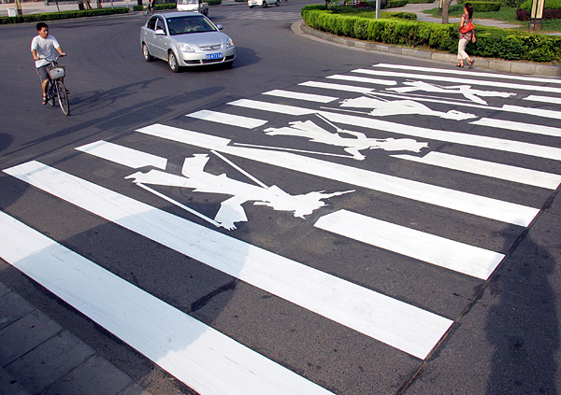
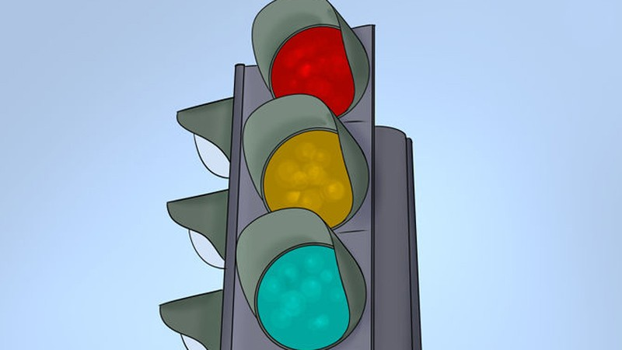
Pedestrian crossing:
/pi,destriən 'krɒsiη/
vạch sang đường
Traffic light:
/'træfik lait/
đèn giao thông

Slide 15
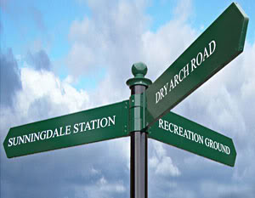
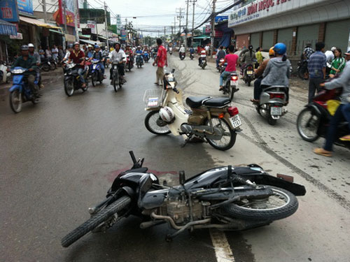
Road sign: biển chỉ đường
/rəʊd/ /sain/
Accident: tai nạn
/'æksidənt/

Slide 16

Other new words
Vehicle: phương tiện
/'vi:ikl/
Passenger: hành khách
/'pæsindʒə[r]/
Oil: dầu
/ɔil/ Diesel: dầu diesel
/'di:zl/ Petrol: xăng
/'petrəl/

Slide 17
He gets .............the car and turns the key on. It is raining ouside and the street is almost empty.
a. On b. in c. out d. off

Slide 18
POSITIVE ADJECTIVES | NEGATIVE ADJECTIVES
Safe quiet Fast relaxing Reliable Eco-friendly Economical Comfortable Energy efficient | Dangerous Noisy slow Stressful Not eco-friendly Crowded
I don’t prefer buses because it is very crowded, and noisy. Besides, it is often late and polluted

Slide 19
Ride a bike = go cycling → cycle
Rush hour: giờ cao điểm

Slide 20
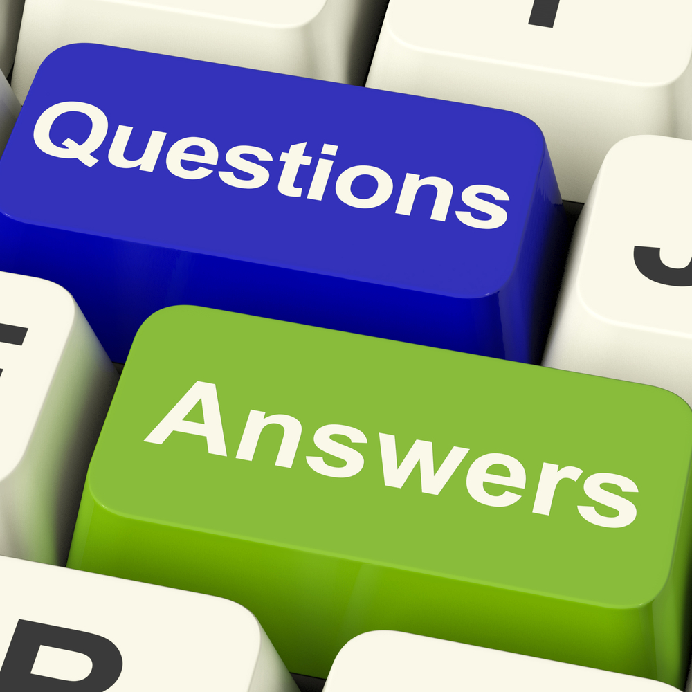

Slide 21
COMMON QUESTIONS
How do you travel around your city?
What is your favorite means of transport?
Do you ever use public transport?
What do you think about public transport in your city?
Do you have a car? What are the advantages of owning a car?

Slide 22
• Do you have a car? If not, does your family have a car?
I wish I could have a car. It is too expensive for me and my family to own a car in Vietnam because of taxes and petrol.
Do you often use public transportation?
Honestly, I rarely use public transportation like bus or train because they are not comfortable for me. Moreover, I like riding my motorbike best.

Slide 23
• Do you ride a bicycle more than once a week?
→ No, I don’t get it, because I’m no longer own a bicycle. But, in the future, I will do it to improve my heath.
• How many times have you traveled by airplane?
→ More than ten times. I often travel to HCM city, Nha Trang city and Da Lat city.
• What do you usually do when riding a train or bus?
→ When riding a train or bus, I usually look at the sceneries and I take some photos.

Slide 24
• What kind of transportation do you use most often? Do you sometimes take a taxi (cab)? • How do you "call" a taxi in your country from the side of the road?
→ I often use motorbike. This means of transport is the most popular in my country.

Slide 25


